Slide 1
Refund / Amount Owed
Pub 4012 Tab K
(Federal 1040-Lines 75-79)
Notes:
1

Slide 2
Federal Refund Options
Refund by check - no action needed
Refund via direct deposit – enter account info twice in TW
Faster & safer
Specify account type
Enter both routing & bank account #s
To split between 2 or 3 accounts, use Form 8888 *
Use refund to purchase bonds
Use refund to apply to next year’s tax liability
* Do not enter amounts for each account until Diagnostics are run & errors corrected, so that refund amount is final
Notes:
If taxpayer chooses to have refund direct deposited, the routing & bank account #s must be entered twice in TW to ensure accuracy
Main Info screen – Bank Account section
1040 Page 2 Line 76
Some taxpayers want to have tax refunds directly deposited into a prepaid debit card account (some employers, like Home Depot & Walmart are using these cards for payroll).
Clients must check to ensure that their accounts accept direct deposit
Client must have official documentation showing routing & account numbers for this account. Do not accept verbal info or numbers written on a piece of paper. The number imprinted on the card is not the same as the account number
2

Slide 3
Direct Deposit Bank Account Info on Main Info screen
Notes:
For direct deposit of a refund, counselor must enter bank routing # & account # under Bank Account section of Main Info screen
Routing # is 9 digits; should be taken from actual check, not deposit ticket
Bank account # should be entered exactly as shown on check, not including the check #
Entering an invalid RTN will result in a 4-6 week delay
New: If bank account number is not taken directly from a check, taxpayer must initial on paper tax return to confirm accuracy
3

Slide 4
Direct Deposit Bank Account Info on 1040 Page 2 Line 76
Notes:
Routing & bank account #s should be entered the exact same way as on Main Info screen
Also indicate whether this bank account is a savings or checking account
4

Slide 5
Refunds Used To Buy Series I Bonds
Do not need an account to purchase bonds; instructions are on Form 8888 in TaxWise
Can buy for co-owners, e.g. - grandchildren
Can buy up to three in a range of amounts
Flat rate interest + semiannual inflation
Can redeem after 12 months (forfeit 3 months’ interest if redeemed < 5 years)
Taxpayer will receive the bonds (via mail or electronically) & a check for balance of refund
Notes:
5

Slide 6
Refunds Applied to Next Year’s Taxes
Can choose to apply all or part of current year’s refund to next year’s taxes
Can apply chosen refund amount just to first estimated tax payment or to all four payments
Use 1040-ES form to enter taxpayer choices. TW will populate amount to be applied to next year on 1040 Line 77 and re-calculate refund taxpayer will receive this year
Notes:
6

Slide 7
Refund Applied to Next Year’s Taxes – 1040-ES Page 1
Amount of estimated taxes specified for next year
Choice of how to apply refund
to next year’s taxes
Amount of refund applied to next year’s taxes
Amounts of refund that will be applied to each estimated tax payment for next year
Notes:
Can complete 1040-ES Estimated Tax Worksheet to figure out taxpayer’s estimated tax liability for next year
OR
Can enter a specified amount that taxpayer wishes to pay in estimated taxes for next year under Line 16
TaxWise will split the estimated taxes into 4 payments on the Amount line under the 4 Payment due dates at the bottom of the screen
Can choose to apply refund to first installment only of estimated taxes for next year or to all estimated tax payments
TaxWise transfers total amount of refund to be applied to next year’s estimated taxes to 1040 Line 77
7

Slide 8
Refund Applied to Next Year’s Taxes – 1040 Page 2 Line 77
TW reduces refund by amount applied to next year’s taxes
Amount to apply to next year’s taxes
from Form 1040-ES
Notes:
TaxWise transfers total amount of refund to be applied to next year’s estimated taxes from 1040-ES
8

Slide 9
Refund Offsets (Garnishments) - Items That Reduce Refunds
Garnishment is when Federal or State agency takes TP’s refund as payment toward a debt.
Unpaid Federal taxes
Unpaid state taxes
Earned Income Credit review
Owed child support
Unpaid student loans
Other non-tax debts
Notes:
Taxpayer’s refund amount may be decreased by the IRS due to the items listed here
This occurs once the tax return is filed & may or may not be expected by taxpayer. Counselor would not be aware of these items
9

Slide 10
Amount Owed: Payment Options
Check or money order - use 1040V voucher
Electronic funds transfer - use ACH form
File return immediately & specify date for transfer
Credit card (additional fee)
Installment payments (must arrange with IRS)
Use Form 9465
Interest & penalties apply
Taxpayer can request 60-120 day deferment but interest & penalties still apply
Notes:
10

Slide 11
Tax Penalty for Underpayment of Taxes
Penalty will NOT be automatically calculated by TW
If it looks like taxpayer will owe penalty (e.g. - owed an amount greater than $1,000 (Federal) /$400 (NJ), then alert taxpayer that they may receive a letter from IRS or NJ
Make a note that alert was given to taxpayer in Intake/Interview sheet notes section & in Taxpayer Diary
Notes:
Counselors should discuss the possibility of an IRS penalty with taxpayer
If there is a penalty, the IRS will notify taxpayer with a letter
11

Slide 12
Conditions When Estimated Tax Payments are Required for Next Year
Taxpayer tax liability in current year more than what was withheld &/or paid in advance AND
Taxpayer expects to owe for next year more than $1,000 (Federal)/$400 (NJ) after subtracting tax withheld & tax credits from tax liability AND
Taxpayer expects next year’s tax withheld to be less than:
90% of the tax liability on next year’s return, or
100% of tax liability shown on current year’s return
Estimated taxes required if taxpayer is self-employed
Notes:
12

Slide 13
Form 1040-ES for Federal Estimated Taxes
Add Form 1040-ES Estimated Taxes Worksheet using Forms icon
Determine how much estimated taxes to pay for next year using one of following methods
Calculate an estimate of next year’s tax liability(Lines 1-16)
Pay 90% of next year’s estimated tax liability
Pay 100% of current year’s tax liability (safe harbor option)
Enter a specific amount to pay on Line 16
4 vouchers will print for submittal
Checks are made payable to US Treasury
Estimated tax payments are due on 4/15, 6/15, 9/15 of next tax year & 1/15 of following tax year
Notes:
13
Options for determining amount of next year’s estimated tax payments:
Pay 90% of next year’s estimated tax liability
Pay 100% of current year’s tax liability (safe harbor option)

Slide 14
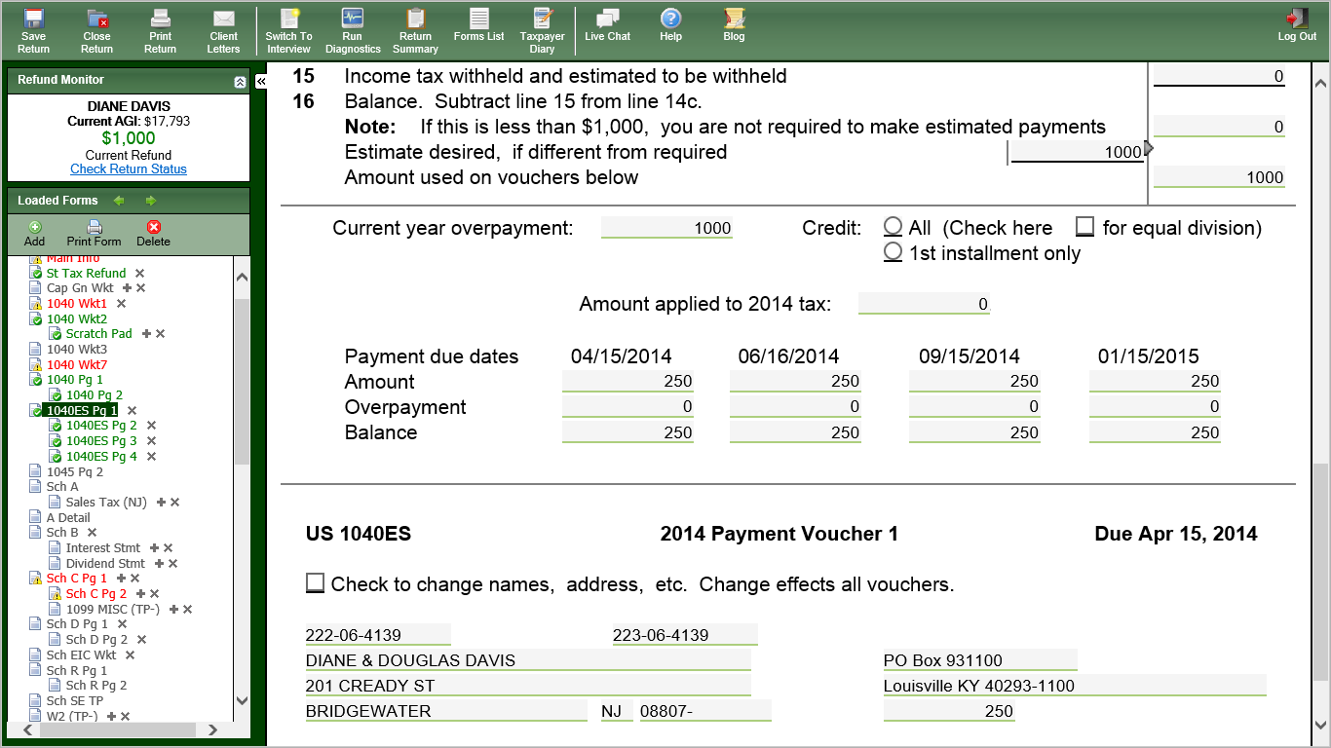
TW Form 1040-ES Federal Estimated Taxes
Specify amount to pay
Estimated tax payment voucher
Notes:
14
Can add form for calculating next year’s estimated taxes due and printing associated vouchers by clicking on Forms List icon & typing in “1040-ES”
Vouchers will print out as part of print package. Point them out to client and explain how to use them
Voucher for estimated tax payment due on 4/15 is on bottom of 1040-ES form. Vouchers for estimated tax payments due on 6/15, 9/15, 1/15 are on subsequent pages
Mail 4/15 estimated tax payment separately from any balance due on current year’s taxes
Include payment voucher cut from bottom of 1040-ES

Slide 15
TW Form 1040-ES Estimated Taxes Voucher
Notes:
15
The first Federal estimated tax voucher is on the bottom of the 1040-ES Worksheet. The other 3 vouchers are on separate pages

Slide 16
TW Form NJ 1040-ES Estimated Taxes
Use current year tax as estimate for next year
Specify amount to pay
Apply current year’s refund to nest year’s estimated tax
Breakdown of 4 payments due, amount applied from current year refund,
and balance still due to be paid
Notes:
16
Can add form for calculating next year’s NJ estimated taxes due and printing associated vouchers by clicking on Forms List icon & typing in “NJ Estimated Taxes.” (cannot type in NJ1040-ES)
Ways to determine how much NJ estimated taxes to pay for next year
Can calculate next year’s estimated tax liability on 1040-ES Lines 1-21
Can specify a specific amount to pay on Line 21
Can use this year’s tax due as estimate for next year
Can apply all or part of current year’s refund to next year’s estimated tax
Can apply refund to first payment only or to equal division across all 4 payments
Vouchers will print out as part of print package. Point them out to client and explain how to use them
Mail 4/15 estimated tax payment separately from any balance due on current year’s taxes

Slide 17
TW Form NJ 1040- ES Estimated Taxes Vouchers
Notes:
17
The 4 NJ estimated tax payment vouchers print on separate pages from the NJ 1040-ES Worksheet

Slide 18
Form W-4 & W-4P - Employee Withholding Allowance
Complete Form W-4 so that employer can withhold the correct Federal income tax from pay
Used if significant current year refund or balance due
Complete Form W-4P for withholdings from pension or annuity
Notes:
18

Slide 19
What If Taxpayer Cannot Pay?
Pay in full within 60 or 120 days with no fee, but interest & penalty will be charged on payments after due date
Apply to make monthly installments using Form 9465 Installment Agreement Request
Fee charged if granted; also interest & penalty
Use credit card to pay
American Express, Discover, MasterCard, Visa
Convenience fee charged by service providers
Notes:
19

Slide 20
NJ Refund Due NJ Direct Deposit or Direct Debit Wkt
For refund, choose 1 of 3 options under Direct Deposit section
Federal refund, NJ refund deposited to same bank account
Do not have to enter routing & bank account #s on NJ return; Federal will be transferred to NJ
Federal refund, NJ refund deposited to different bank account
Also choose this option if balance due for Federal, but refund for NJ
Notes:
We may see more situations like option 2 since we are e-filing the NJ return to claim the $50 property tax credit even if the taxpayer is under the filing threshold for both Federal and State. E-file both Federal & NJ returns

Slide 21
NJ Refund Due NJ Direct Deposit or Direct Debit Wkt
Must enter routing #, bank account # & type of account for the different bank account in 2 places on NJ DD Wkt—in Bank Account Information section & in Electronic Filing Only section
Refund check mailed to taxpayer
Must answer question about foreign bank account at bottom of screen

Slide 22
NJ Balance Due NJ Direct Deposit or Direct Debit Wkt
If balance due, choose 1 of 2 options under Direct Debit section
Balance due withdrawn from bank account
Must enter routing #, bank account #, & type of account in 2 places
Must enter date to have balance due withdrawn (may be any date up to date return is due)
Mail balance due to NJ
Must answer question about foreign bank account at bottom of screen

Slide 23
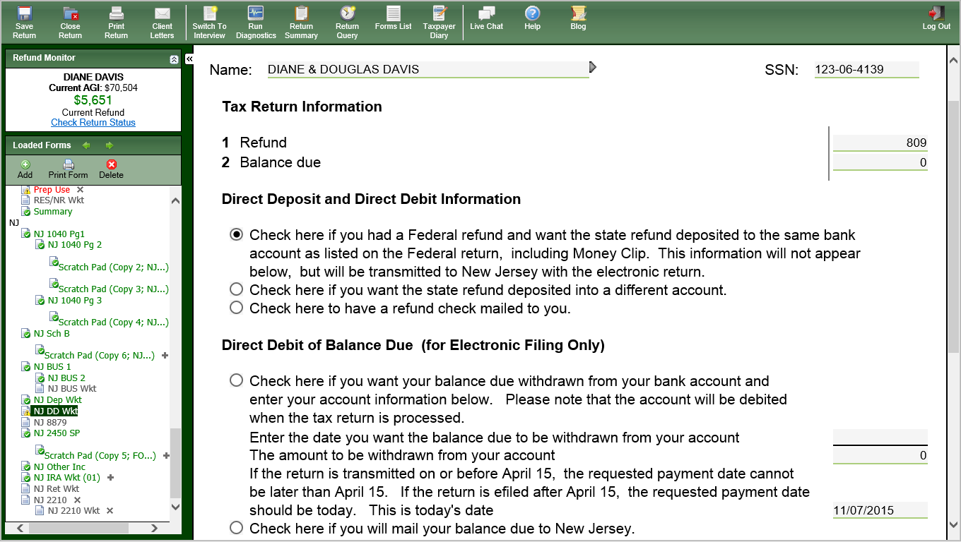
TW NJ Direct Deposit or Direct Debit Worksheet
If same as Federal, no need to enter bank info
If different than Federal, must enter bank info twice below
If refund check is desired
If direct debit, enter bank info twice below & date of withdrawal
If check will be mailed in
Notes:
If there is a balance due for Federal, but a refund due for NJ, use “Check here if you want the state refund deposited in a different account” option under Direct Deposit section

Slide 24
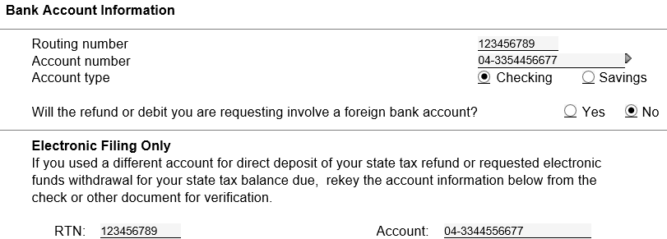
TW NJ Direct Deposit or Direct Debit Worksheet
Enter bank info twice
For any direct deposit or direct debit, must answer question about foreign bank account (even if same as Federal)

